Slide 1

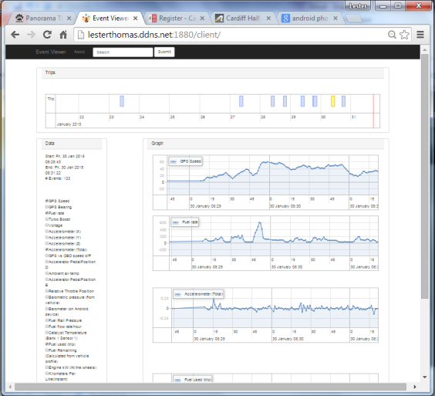
OBD II device
Android Phone
Upload
Bluetooth
Cellular
Analyse

